Slide 1

WhyR Text Mining Hackathon Challenge 2
Team MAP
By Michael Yuen, Alvin Nursalim, Philip Li

Slide 2

Cleaning the Data
Converted HTML encodings of special characters into string literals
Remove number digits, HTML text, general URLs from comments and article titles

Slide 3
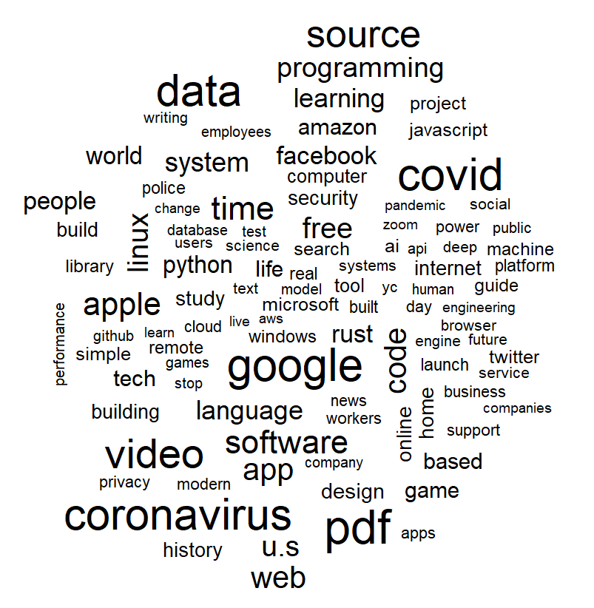
Exploratory Data Analysis
Grouped comments by user, generating a sparse DTM
Word cloud of article titles showed that the HackerNews website predominately hosts topics of technology & lifestyle topics

Slide 4
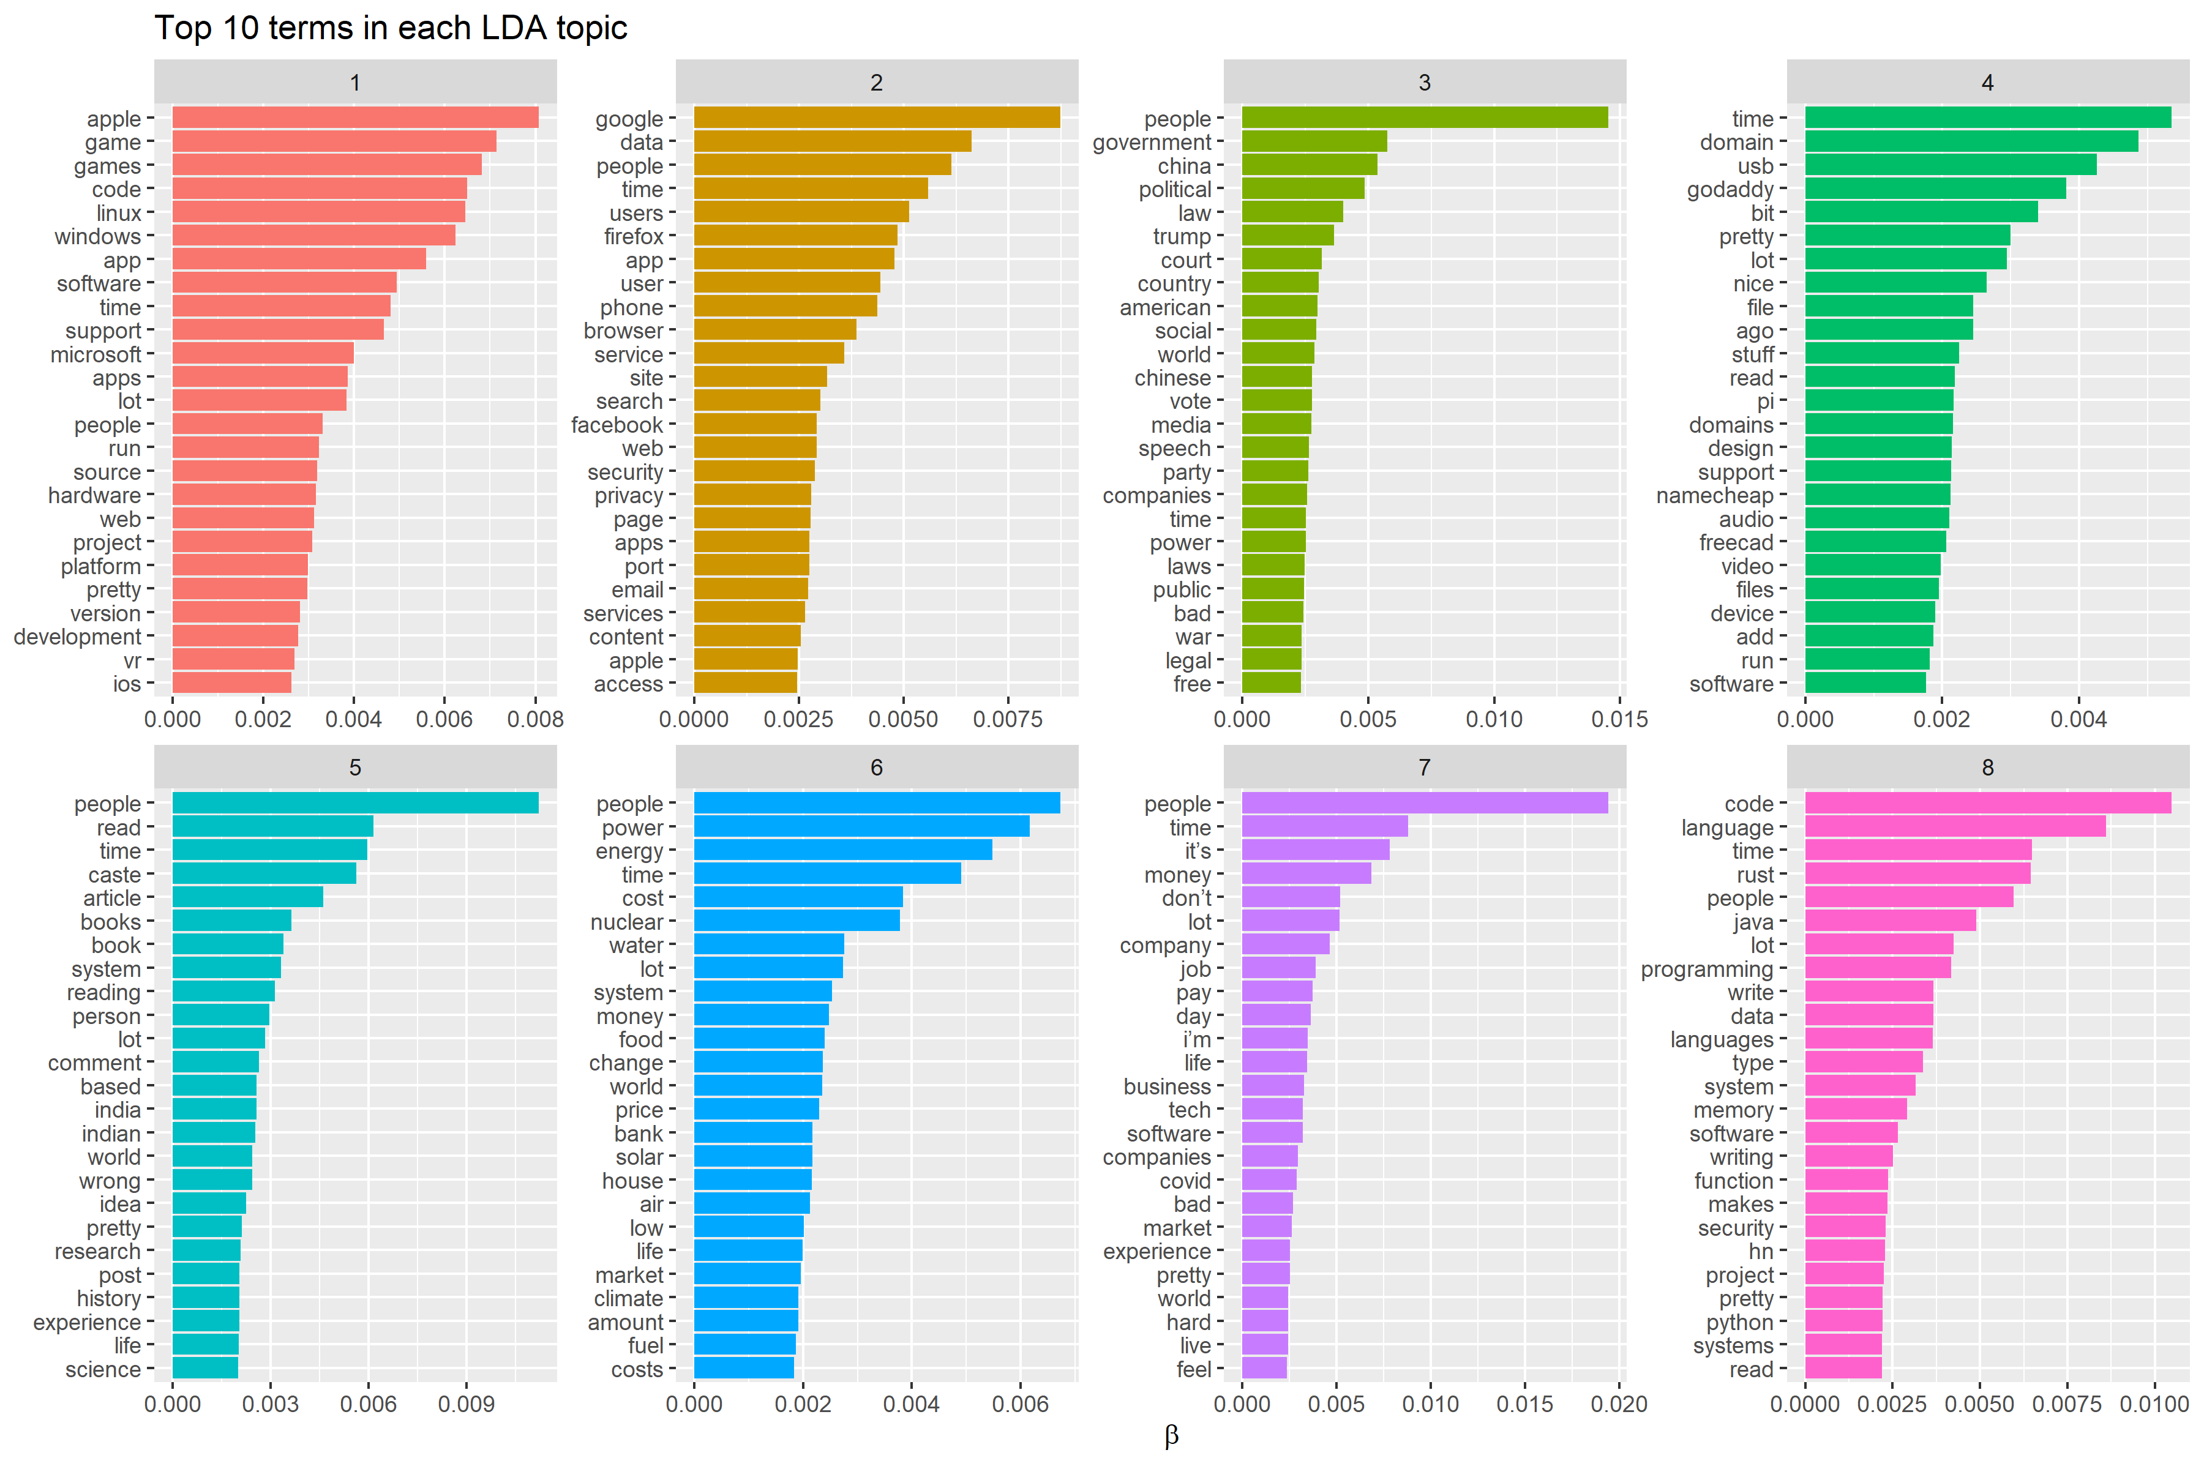
Modeling
LDA topic modeling; betas are per-topic-per-word probabilities, gammas are per-document-per-topic probabilities
Experimented with 2-10 groups using LDA, determining 8 groups by inspection

Slide 5
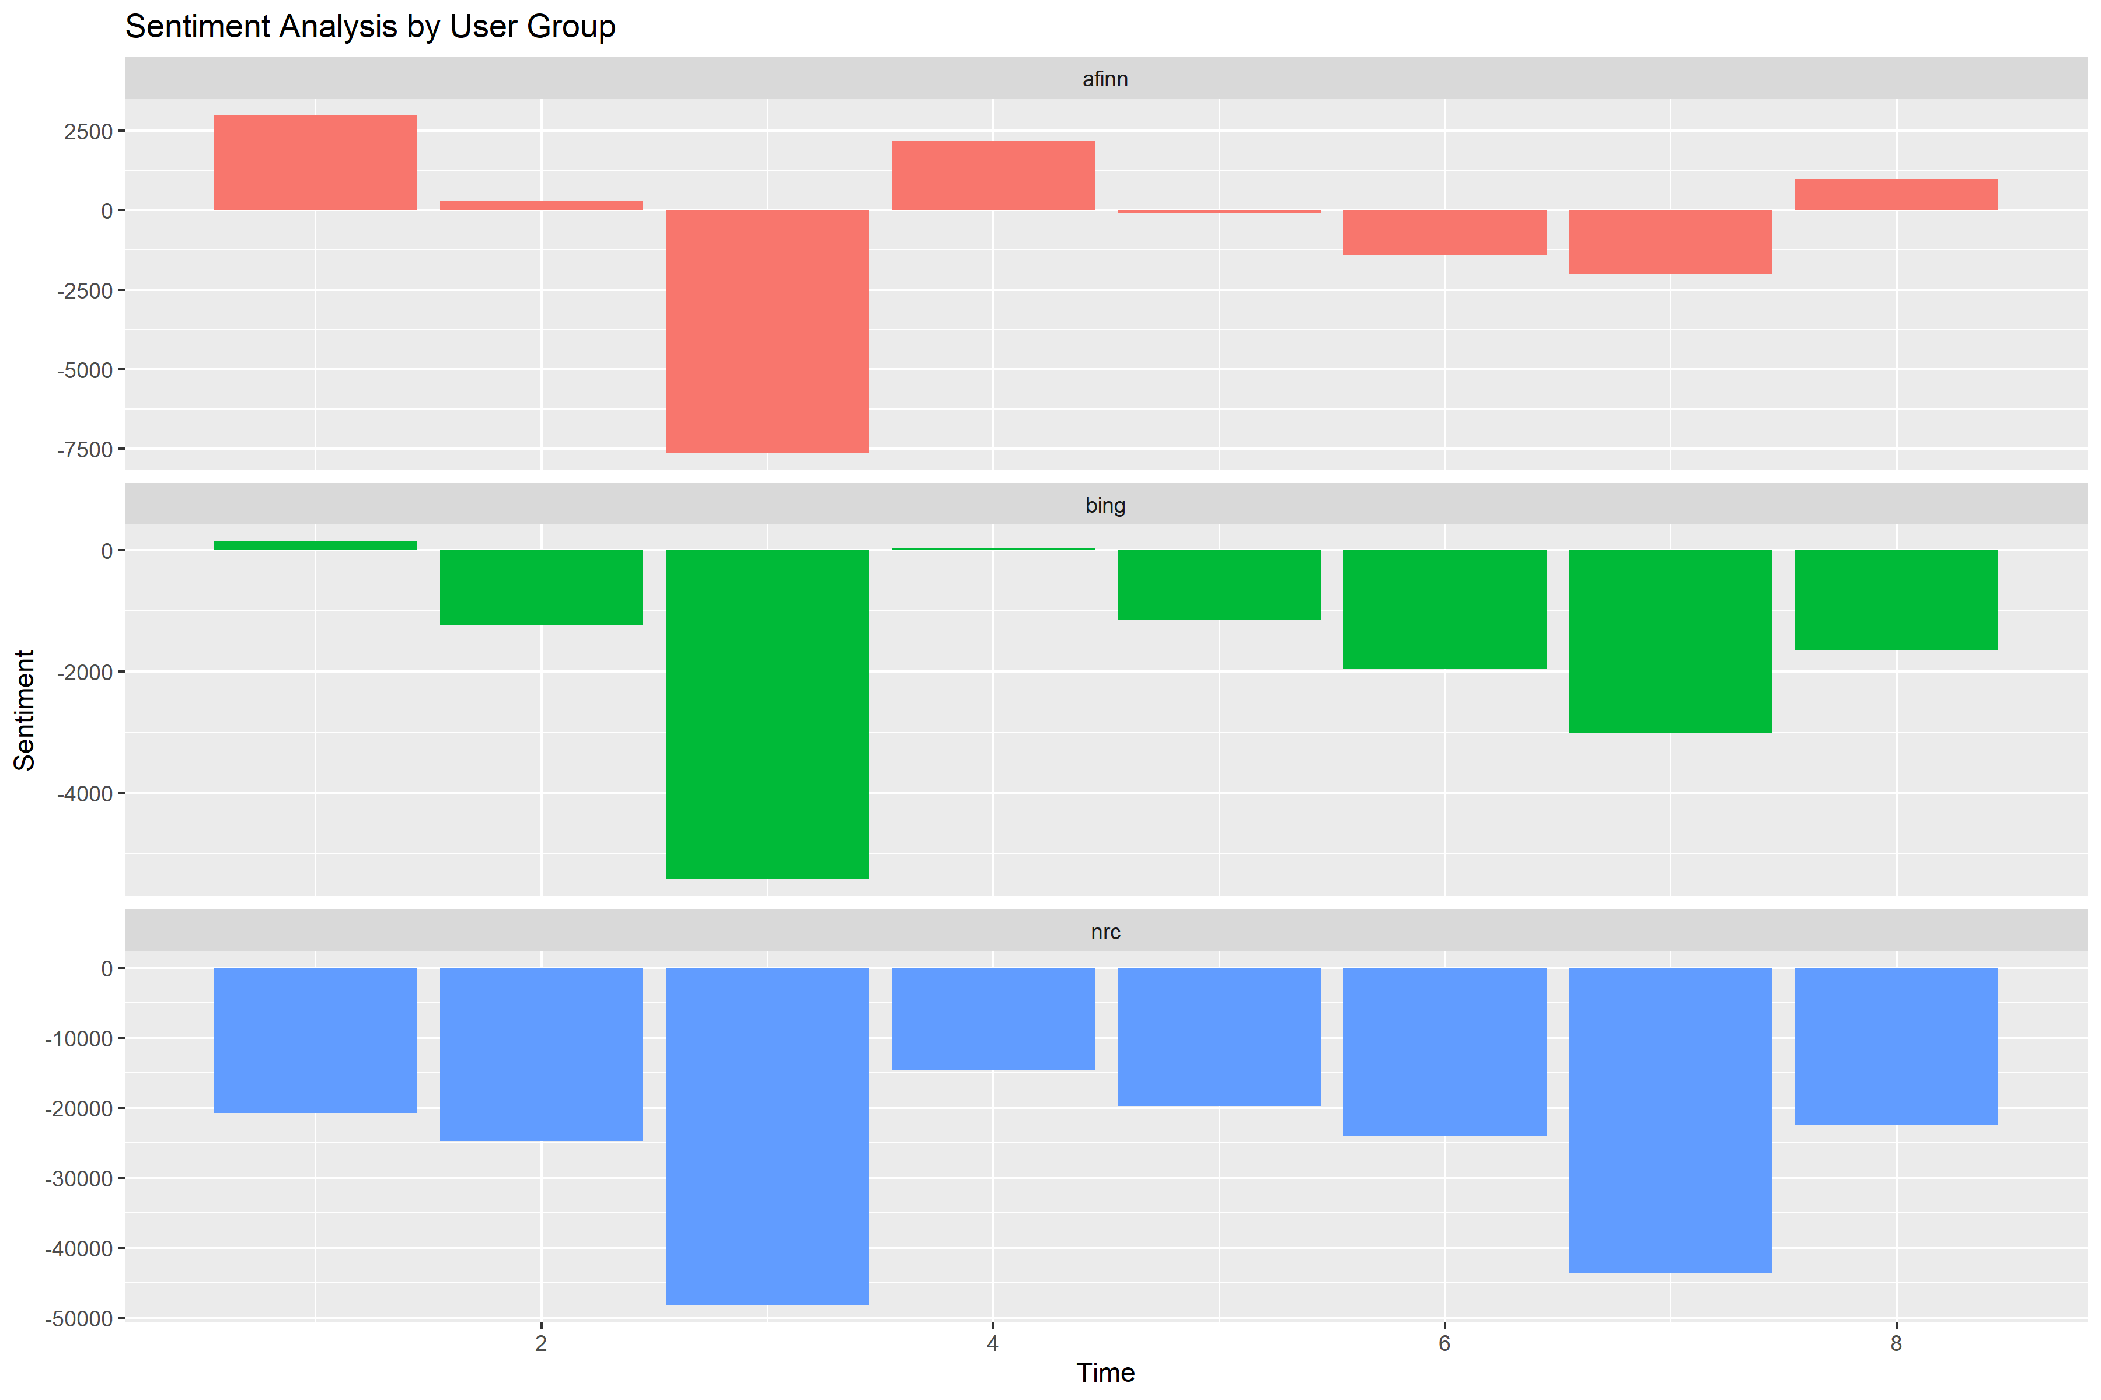
Sentiment Analysis By Group
Performed sentiment analysis using AFFIN, Bing and NRC lexicons
Found AFFIN lexicon to be most effective at showing the emotions being conveyed through text
Decided to proceed using AFFIN lexicon and discovered 4 positive groups and 4 negative groups

Slide 6
Common Words of Each Group
We’ve categorized the groups to our own assumptions* based on these most common words
1 – Tech enthusiast group
2 – Internet experience group
3 – Politics group
4 – Media group
5 – Books & History group
6 – Energy group
7 – Lifestyle & Current Events group
8 – Software Development group
Common Words by Group
* this is an assumption made on our behalf. This was not meant to improperly categorize or stereotype common words for each group.

Slide 7
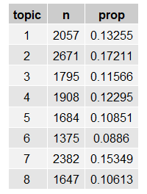

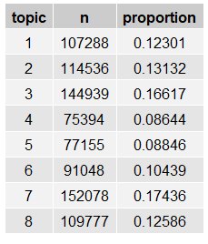
Amount of Comments Generated by Each Group
2. Proportion of Users in each group
Assigned each user a probability of belonging to a specific group, using best fit LDA model.
Took highest probability using splice_max( ) to assign a group to each user
Calculated:
# comments in group / total # comments
# users in group / total # users who commented
# words in group / total # words
1. Proportion of Comments made per group
3. Proportion of words in each group

Slide 8
Amount of Comments Generated by Each Group
2. Proportion of Users in each group
Assigned each user a probability of belonging to a specific group, using best fit LDA model.
Took highest probability using splice_max( ) to assign a group to each user
Calculated:
# comments in group / total # comments
# users in group / total # users who commented
# words in group / total # words
1. Proportion of Comments made per group
3. Proportion of words in each group

Slide 9
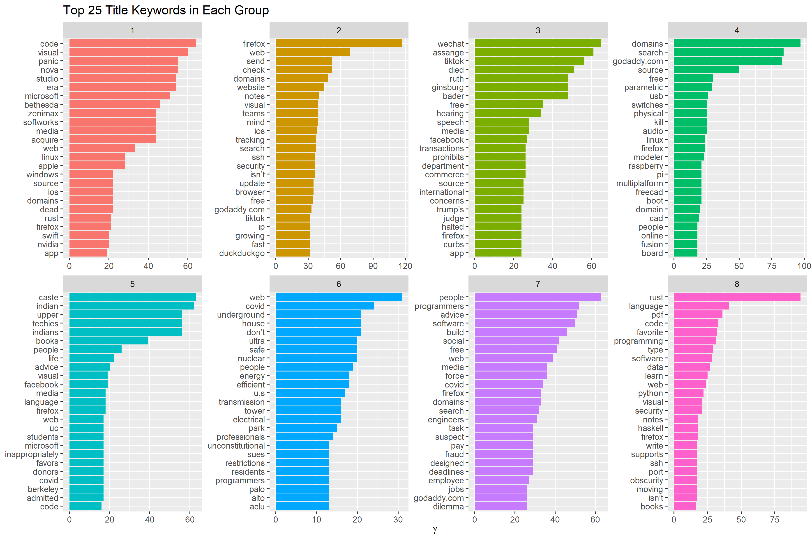
Article Title Keywords by Group
Looking at the charts, the title keywords support our user groups segmentation

Slide 10
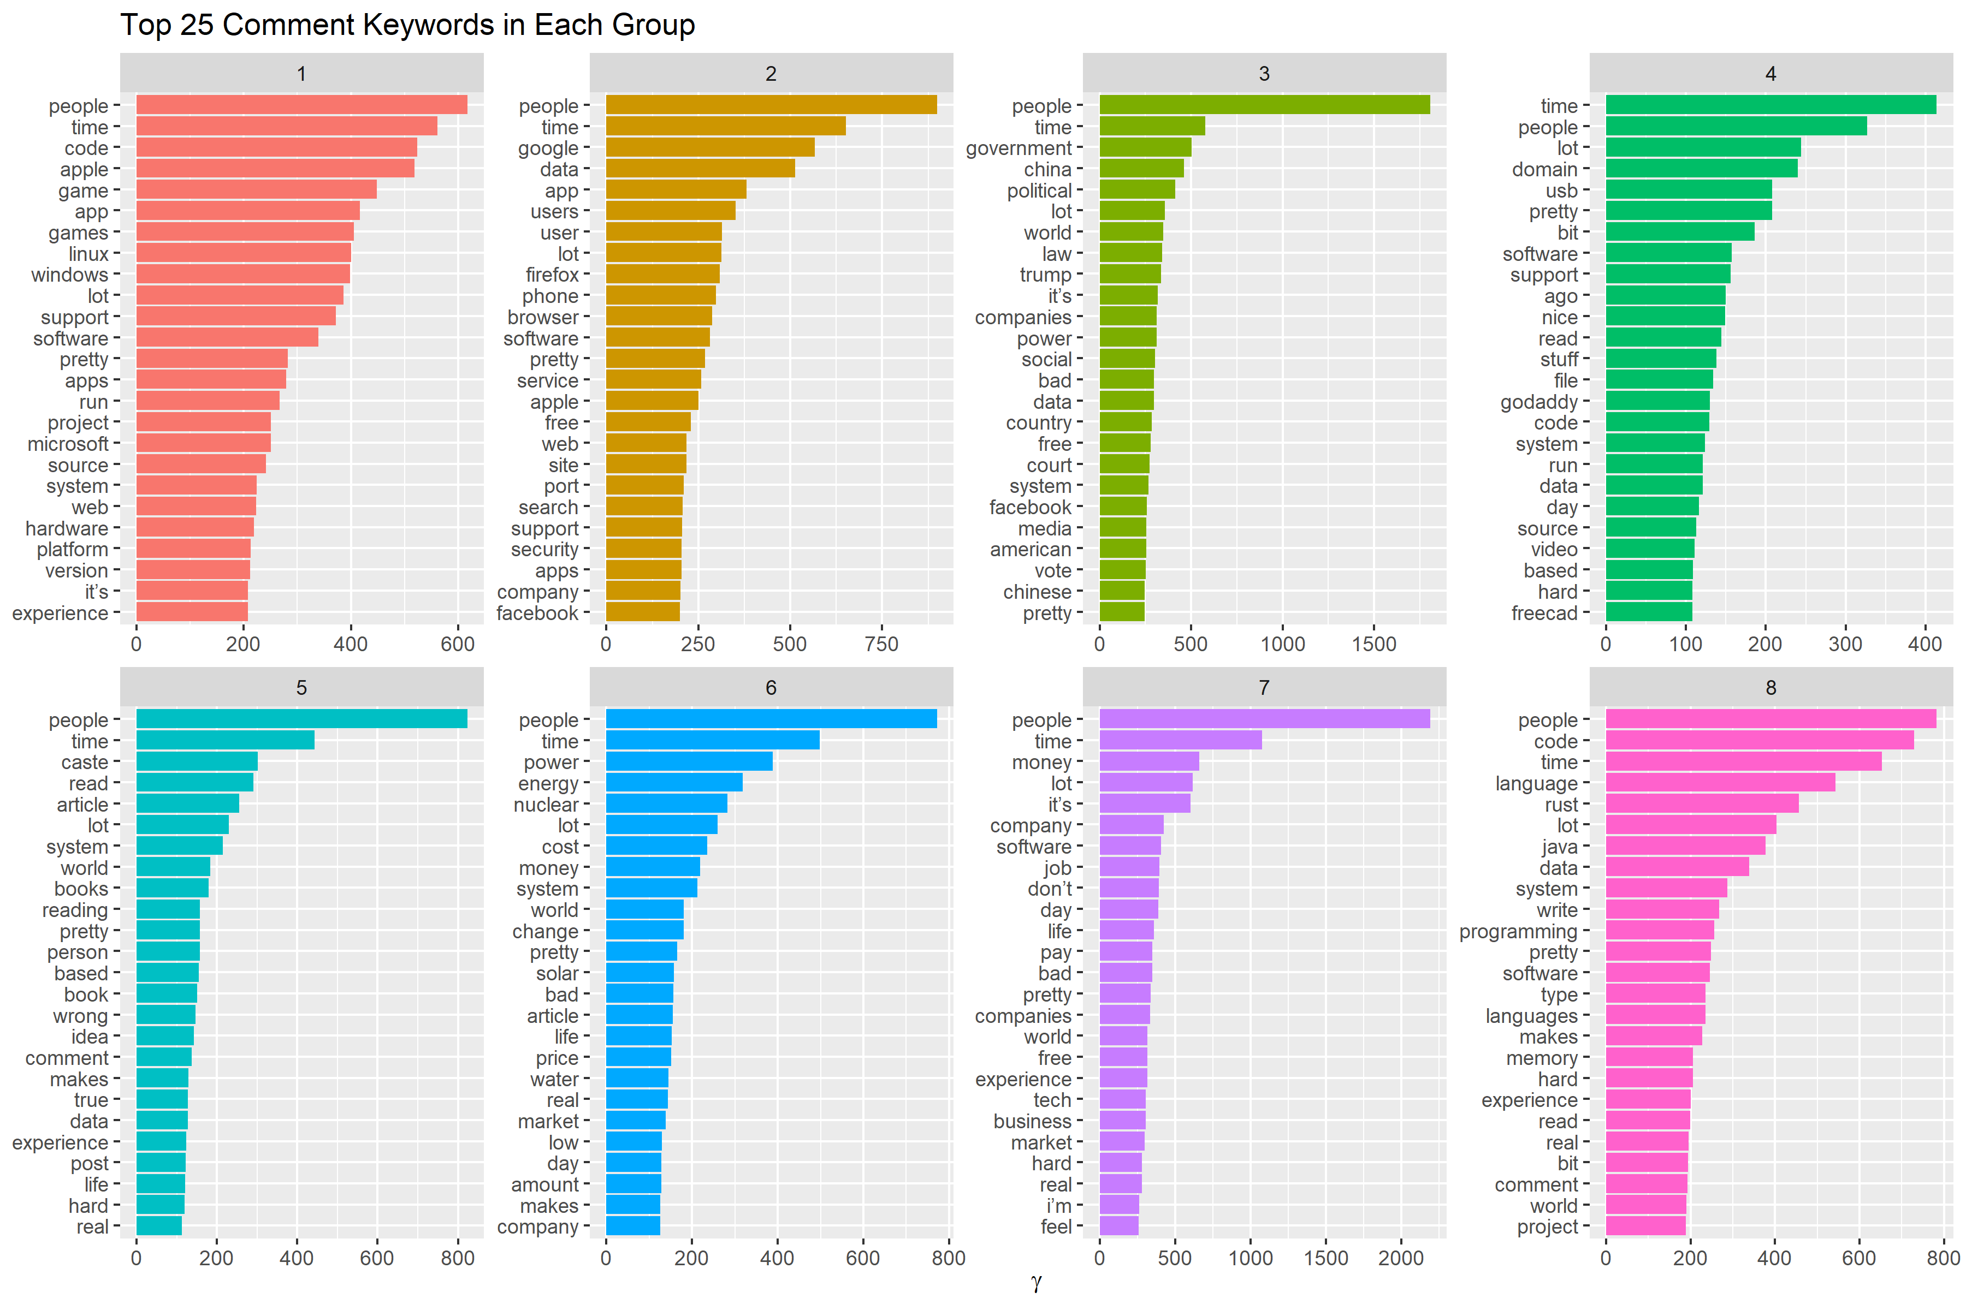
Top Words Commented by Group
Each group writes comments on their articles of interest with the vocabulary on the charts

Slide 11
Executive Summary
To Mr./Ms. CEO of Hacker News:
After our analysis, we found that there were 4 of 8 groups within the Hacker News community showing universal positive sentiment. The remaining 4 groups had universally negative sentiment, with one group showing much higher negativity. This group sized 1795 of 15519 users (11.6%) contributed to 16.1% of the total comments and 16.6% of total words.
Based on the number of groups determined by LDA, we confirmed that the commenters were posting to articles which identified with the theme of the groups. We are confident that the groups identified, accurately segment the population of Users into meaningful groups, guiding business decisions regarding content curatation to better target audiences and to keep them engaged to increase active time.
Source Code: https://github.com/mwkyuen/whyR_challenge2

Slide 12

Thank you for your time.

